Slide 1

Session 5

Slide 2

Agenda
Session 5
Homework discussion
Quiz
Table valued functions
Workshop
Variables and constants
Row variables
Record types
Constants
Workshop
Control structures
If statement
Workshop
Knowledge check (Discussion, Homework)

Slide 3
Homework discussion

Slide 4
Quiz

Slide 5
Table valued functions

Slide 6
Table valued functions
A table valued function is usually a name for functions that return a table.
To define a function that returns a table, you use the following form of the create function statement:
create or replace function function_name (
parameter_list
)
returns table (column_list)
language plpgsql
as $$
declare
-- variable declaration
begin
-- body
end; $$

Slide 7
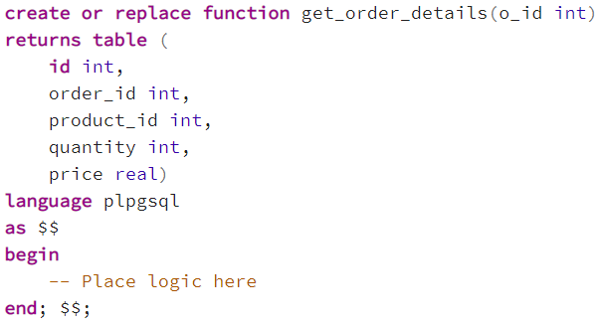
Workshop 1/3
Create a table valued function that for a specific order returns every column of the OrderDetails table.

Slide 8
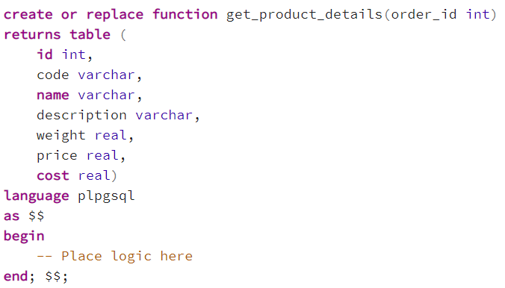
Workshop 2/3
Create a function that returns all product table columns for a given order ID.

Slide 9
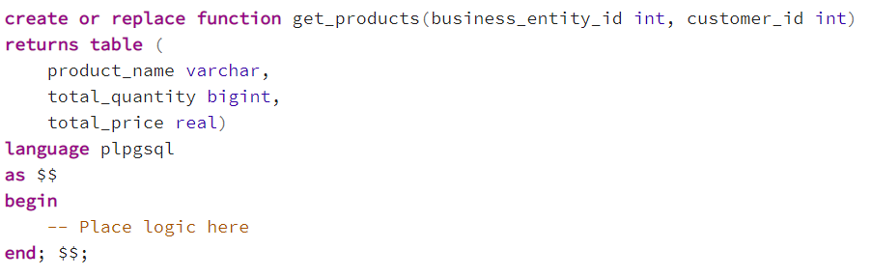
Workshop 3/3
Create a table valued function that for a specific BusinessEntity and Customer will return list of products sold, together with the total quantity sold and total price per product.

Slide 10
Variables and constants

Slide 11
Row variables (row type)
To store the whole row of a result set returned by the select into statement, you use the row-type variable or row variable.
You can declare a variable that has the same datatype as the datatype of the row in a table by using the following syntax:
To access an individual field of the row variable, you use the dot notation (.) like this:
row_variable table_name%ROWTYPE;
row_variable view_name%ROWTYPE;
row_variable.field_name

Slide 12
Record types
PostgreSQL provides a “type” called the record that is similar to the row-type.
To declare a record variable, you use a variable name followed by the record keyword like this:
A record variable is similar to a row-type variable. It can hold only one row of a result set.
Unlike a row-type variable, a record variable does not have a predefined structure. The structure of a record variable is determined when the select or for statement assigns an actual row to it.
To access a field in the record, you use the dot notation (.) syntax like with row types.
variable_name record;

Slide 13
Constants
Unlike a variable, the value of a constant cannot be changed once it initialized.
Constants make code more readable and maintainable.
To define a constant in PL/pgSQL, you use the following syntax:
constant_name constant data_type := expression;

Slide 14
Workshop 1/2
Create a function that for a specific order returns the name of the product. Use row variables for the result sets of both the Product and OrderDetails tables.
Create a function that for a specific product ID returns all information for all customers that bought it. Store the result sets of the intermediate tables in row variables.
Create a function that returns all information of the product connected to a specific order ID. Use a record to store the intermediate result set.

Slide 15
Workshop 2/2
Create a function that:
Returns the totalPrice from Orders table, price from OrderDetails table and price from Products table for a given order ID.
Uses records to store the result sets.
Returns all three values concatenated into a string into the following format: ‘ORDER_TOTAL_PRICE: %; ORDER_DETAIL_PRICE: %; PRODUCT_PRICE: %’.
Each value is to be modified by a percentage, order’s total price 20%, order detail’s price by 15% and product’s price by 10%. Store all three percentages as constants.

Slide 16
Control structures

Slide 17
If statement
The if statement determines which statements to execute based on the result of a boolean expression.
PL/pgSQL provides you with three forms of the if statements.
if then
if then else
if then elsif

Slide 18
if-then statement
The if statement executes statements if a condition is true. If the condition evaluates to false, the control is passed to the next statement after the END if part.
The condition is a boolean expression that evaluates to true or false.
The statements can be one or more statements that will be executed if the condition is true. It can be any valid statement, even another if statement.
When an if statement is placed inside another if statement, it is called a nested-if statement.
if condition then
statements;
end if;

Slide 19
if-then-else statement
The if then else statement executes the statements in the if branch if the condition evaluates to true; otherwise, it executes the statements in the else branch.
if condition then
statements;
else
alternative-statements;
END if;

Slide 20
if-then-elsif statement
if condition_1 then
statement_1;
elsif condition_2 then
statement_2
...
elsif condition_n then
statement_n;
else
else-statement;
end if;

Slide 21
Found variable
The found is a global variable that is available in PL/pgSQL. If the select into statement sets the found variable if a row is assigned or false if no row is returned.
select * from table_name
into table_record
where condition;
if not found then
-- Raise an error
end if;

Slide 22
Workshop
Create a function that returns the name of the product for a given product ID. If a product does not exist with that ID, show a notice. Use an if statement to determine if the product exists.
Create a function that returns the name of a product for a given order ID, only if the order’s total price is above 50. If it’s below than 50, raise a notice saying so. If an order with that ID does not exist, show a different message.
Create a function that returns the customer’s name if an order’s quantity is less than 50, or the business entity’s name if it is higher than 50. Determine the order by providing its ID. If it does not exist, show a message.

Slide 23
Homework 5

Slide 24
Homework
Create a function that returns all information from the products table for a given order ID, using a row variable.
Create a function doing the same thing from above but using a record.
Create a function that will return all customers that bought a certain product, determined by the product ID, with all of their information.
Create a function that returns the quantity for a given order ID, only if the quantity is bigger than 50. If it is not, raise a notice. Use the if/else statement.
Create a function that returns all customers that bought a certain product, only if their name starts with a, e, i, o, u. If there are none, use an if/else statement to raise a notice.

Slide 25
QUESTIONS

